Slide 1

Searching the literature
DEPH 312 Principles of Scientific Evidence
Talal Alshihayb
22 January 2023
shihaybt@ksau-hs.edu.sa

Slide 2
If you lost your phone in a mall, what would you do?

Slide 3
Literature search/review
Investigating what is out there about a certain topic
Books
Journals and papers
Preprints
Unpublished papers
Etc.
Why?
If you have an idea in mind
To make sure an idea was not done before
If done before, does it need replication
To refine the research question
To help know what methods/measurements/analysis to do
If you are looking for a research idea
Look for a research problem that needs to be answered
Look for gaps that are present in a topic
To learn about a topic (i.e., keep up with updates)

Slide 4
Literature search
Need to know what you are searching
Identify keywords that would pick what you are searching
Need to know where you search using those keywords

Slide 5
Need to know what you are searching
Back to research question
PICOT:
P: population
I/E: intervention/exposure
C: comparison
O: outcome
T: time

Slide 6
Give me an example of a research question

Slide 7
PICOT of the example
P:
I/E:
C:
O:
T:

Slide 8
Identify keywords that would pick what you are searching
P:
I/E:
C:
O:
T:

Slide 9
Need to know where you search using those keywords
Databases
Includes
Publishers
Includes
Journals
Includes
Papers

Slide 10
Need to know where you search using those keywords
Search electronic databases using keywords with (and, or, not)
MEDLINE (Medical Literature Analysis and Retrieval System)
PUBMED
EMBASE
CINHAL
Cochrane library
Scopus
Trial registries
Etc.
Manual search using references of studies (cross-referencing)

Slide 11
Literature search/review
Idea
Literature search
Discussion with expert colleagues
Refine Idea
Literature search
Finalized research question

Slide 12
How to do a literature review
Screen the title, abstract, and/or study to identify relevant papers
Idea
Keywords
Boolean operators
and/or/not
Extract articles to a library, a citation manager, and excel
Summarize the relevant papers
Refine idea
Formulate the final the research question
Write the introduction

Slide 13
Tutorials on literature search
https://www.youtube.com/watch?v=0lill6yUmk8
https://www.youtube.com/watch?v=HYW2_eUsK9E
https://www.youtube.com/watch?v=-SR1951DE4Y
https://www.youtube.com/watch?v=OIgGFz-_8os
https://www.youtube.com/watch?v=JCqNSlnte_8

Slide 14

https://www.cocites.com/

Slide 15
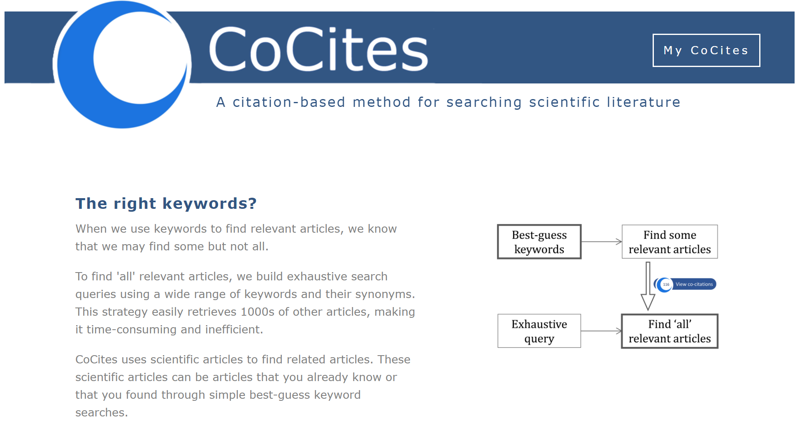
https://www.cocites.com/

Slide 16
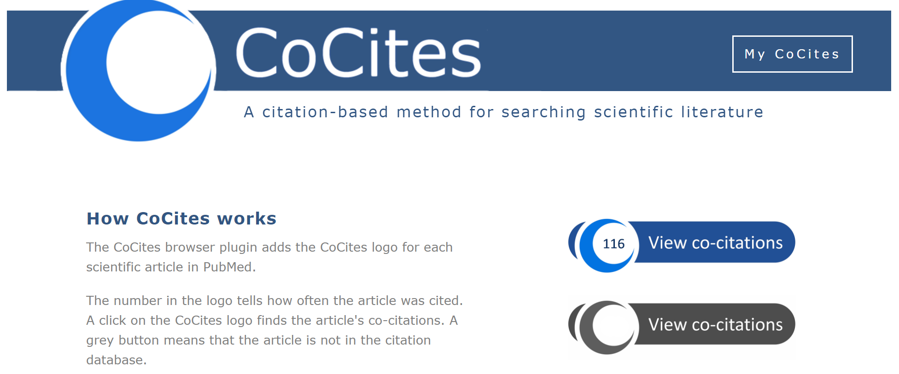
https://www.cocites.com/

Slide 17
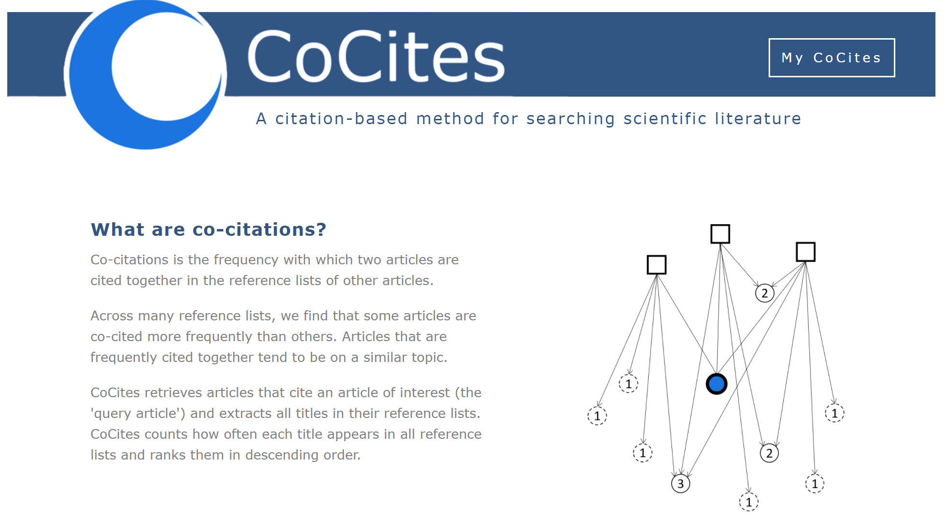
https://www.cocites.com/

Slide 18

https://www.cocites.com/

Slide 19


Slide 20
Other literature search methods
https://www.connectedpapers.com/
https://www.researchrabbit.ai/
https://openknowledgemaps.org/
https://inciteful.xyz/
https://www.jstor.org/analyze/
https://www.vosviewer.com/

Slide 21
Types of access to papers
Closed (you need to pay for it through subscription or per paper)
Open (free)

Slide 22
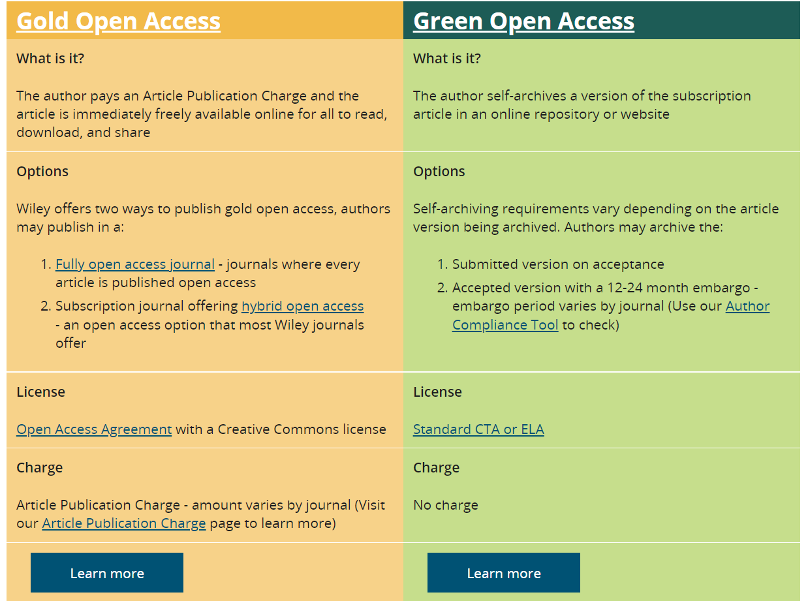
https://authorservices.wiley.com/author-resources/Journal-Authors/open-access/index.html

Slide 23

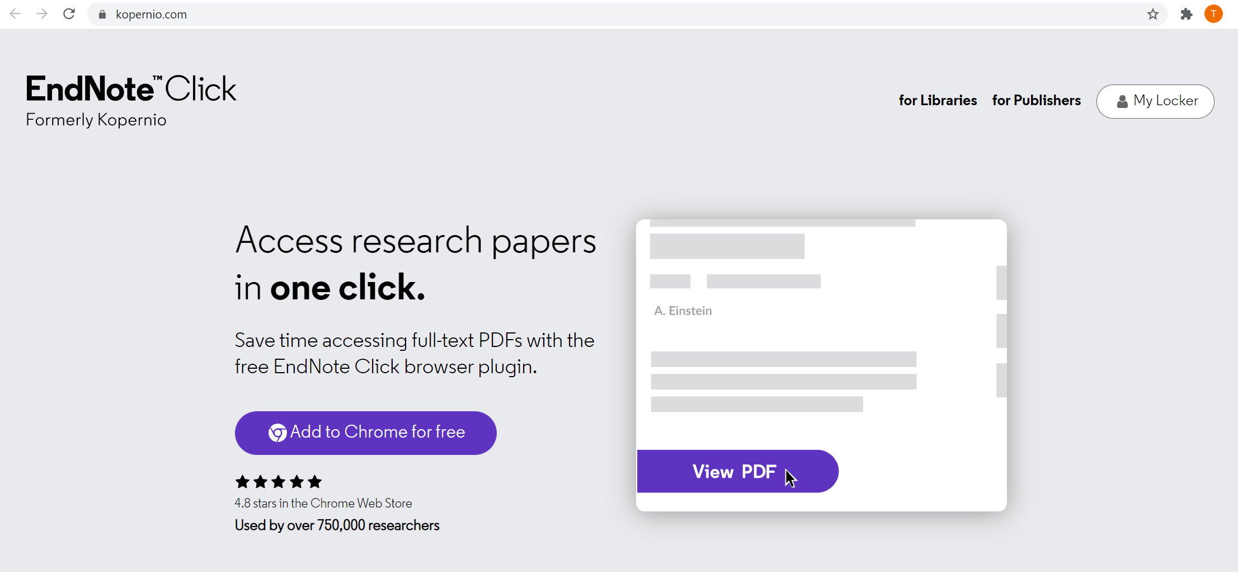

Full text access

Slide 24
Full text access
Through the Saudi Digital library (you can access it through Blackboard)

Slide 25
Full text access
There are illegal websites out there that you can use to get a full text for free
Sci-hub is one such website
You can be legally implicated in the United States if you use it there
Please do not use sci-hub in Saudi to access full text articles for free

Slide 26
How to do a literature review
Screen the title, abstract, and/or study to identify relevant papers
Idea
Keywords
Boolean operators
and/or/not
Extract articles to a library, a citation manager, and excel
Summarize the relevant papers
Refine idea
Formulate the final the research question
Write the introduction

Slide 27
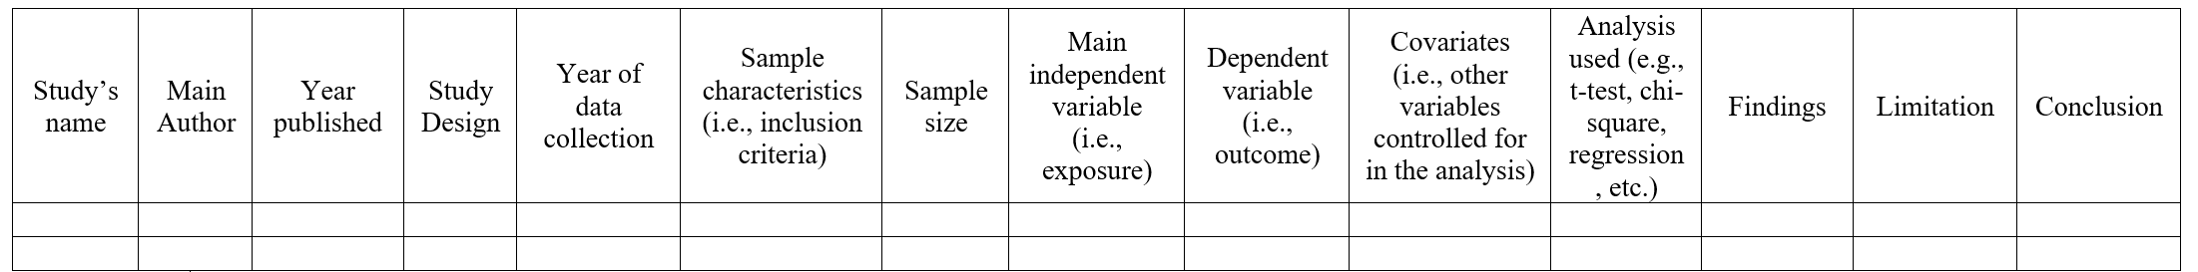
Summarizing the literature
Read article by article
Summarize each article
Commenting on the paper as you read it
Writing your comments on word document/excel sheet as you read the paper
Write a summary of the article after you read it in text or table

Slide 28
How to do a literature review
https://www.youtube.com/watch?v=lw8HPXJP1VA
https://www.youtube.com/watch?v=kW6Uzn-8uMI
https://www.youtube.com/watch?v=zIYC6zG265E
https://www.youtube.com/watch?v=-ny_EUJXHHs
https://www.youtube.com/watch?v=U7w-5cx6NM4&t=1934s
https://www.youtube.com/watch?v=7XMxttSn9CA (also covers exporting to excel sheet at minute 55:20)
https://twitter.com/13adh13/status/1406664117147123715 (check this short helpful thread)

Slide 29
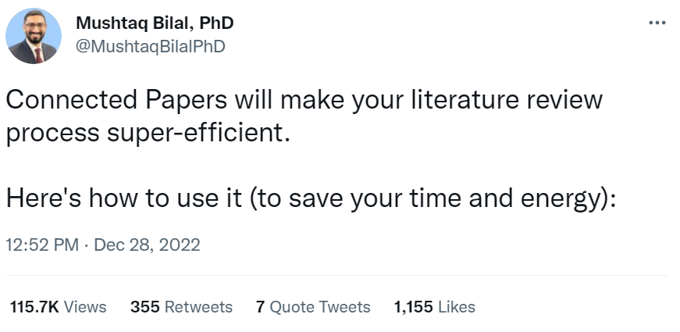
https://twitter.com/MushtaqBilalPhD/status/1608038262244777984

Slide 30
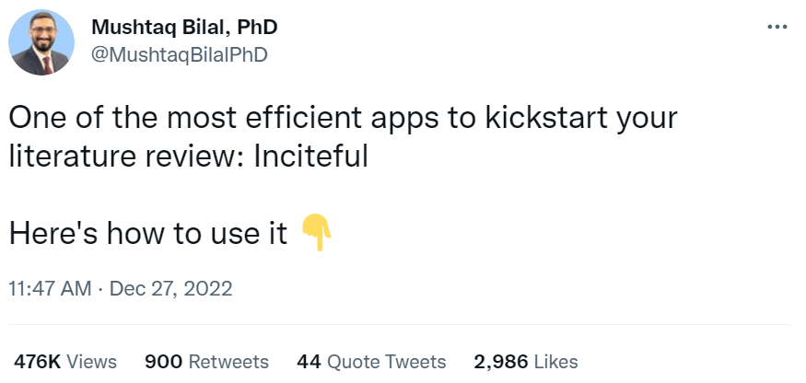
https://twitter.com/MushtaqBilalPhD/status/1607659489003728896

Slide 31
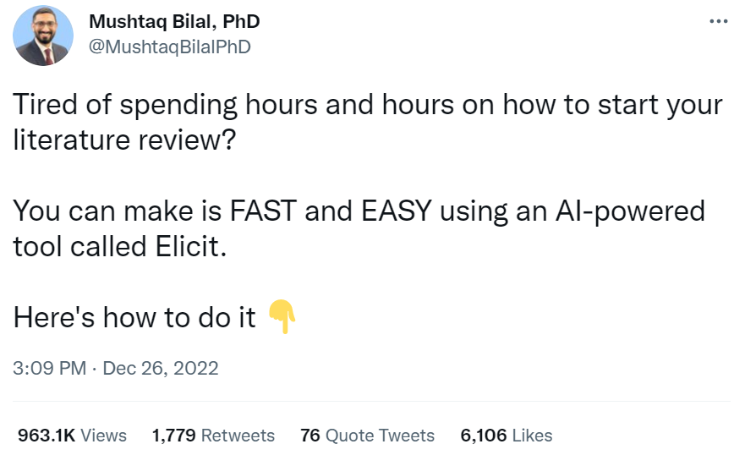
https://twitter.com/MushtaqBilalPhD/status/1607347756498096128

Slide 32
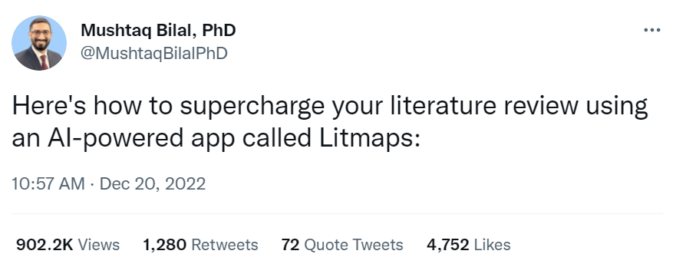
https://twitter.com/MushtaqBilalPhD/status/1605110005266386944

Slide 33
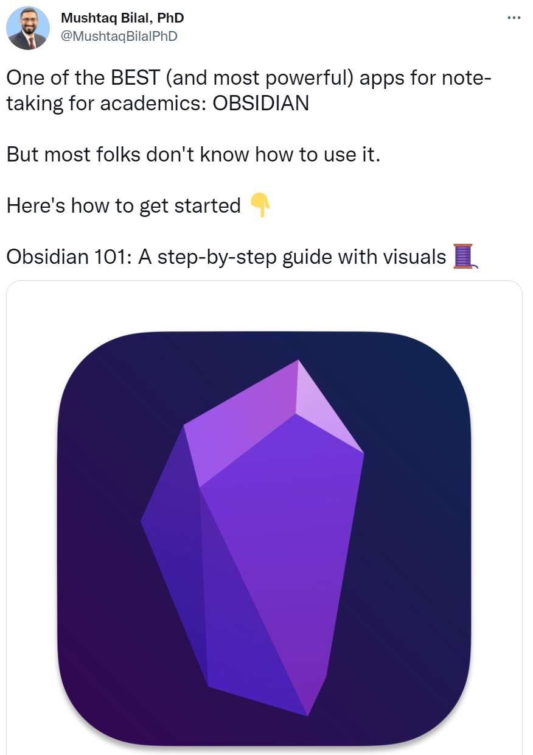
https://twitter.com/MushtaqBilalPhD/status/1602568559284178950

Slide 34
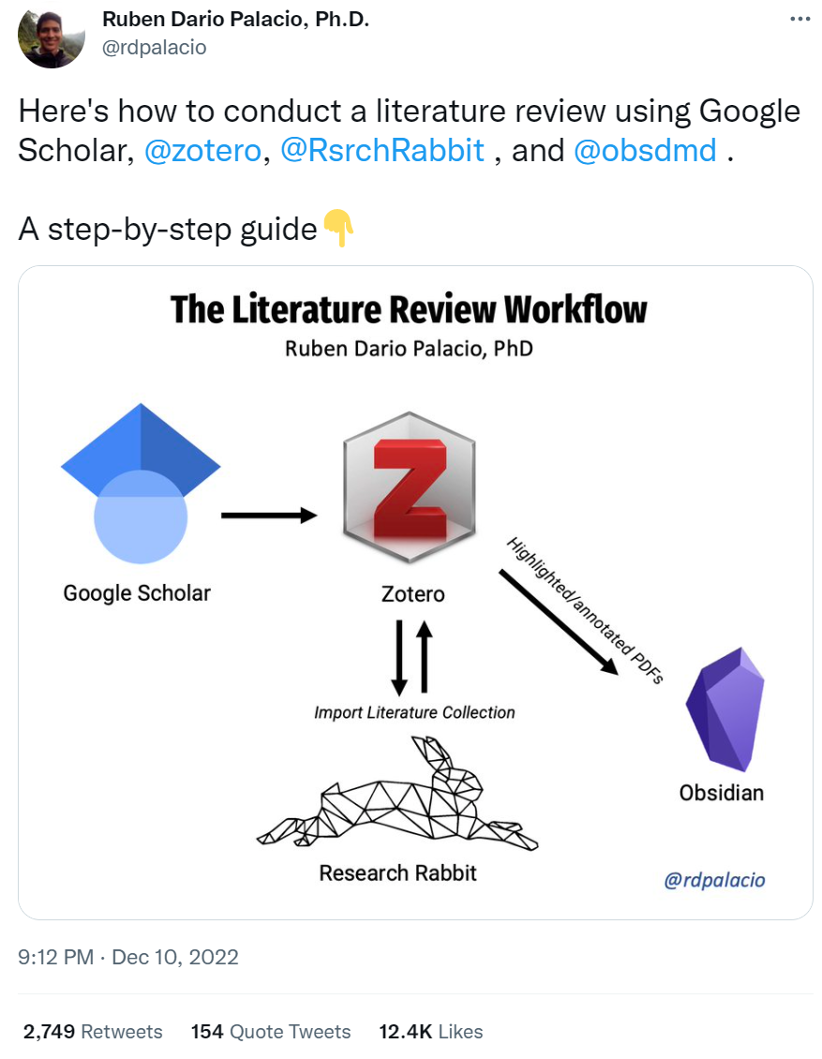
https://twitter.com/rdpalacio/status/1601640985858957312

Slide 35
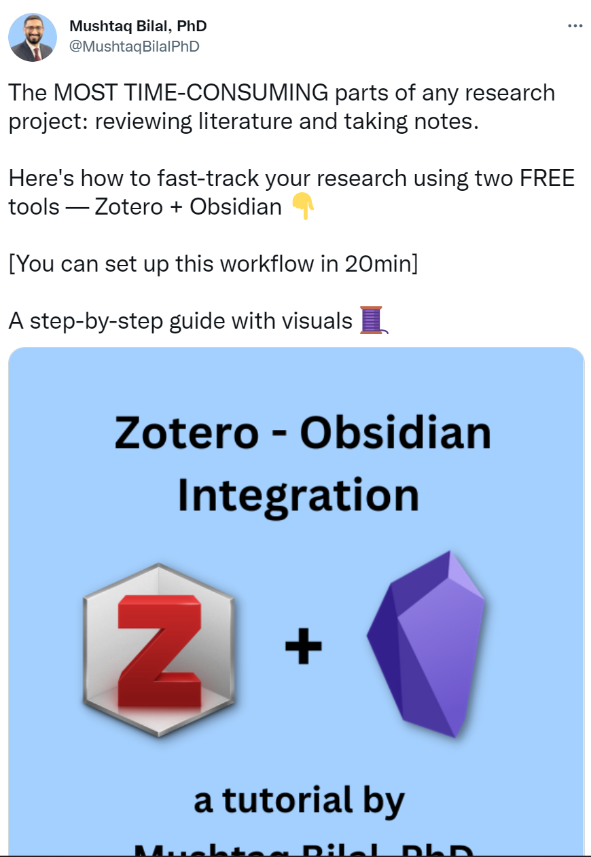
https://twitter.com/MushtaqBilalPhD/status/1603279910537158656

Slide 36
Any Questions?
shihaybt@ksau-hs.edu.sa

